Slide 1
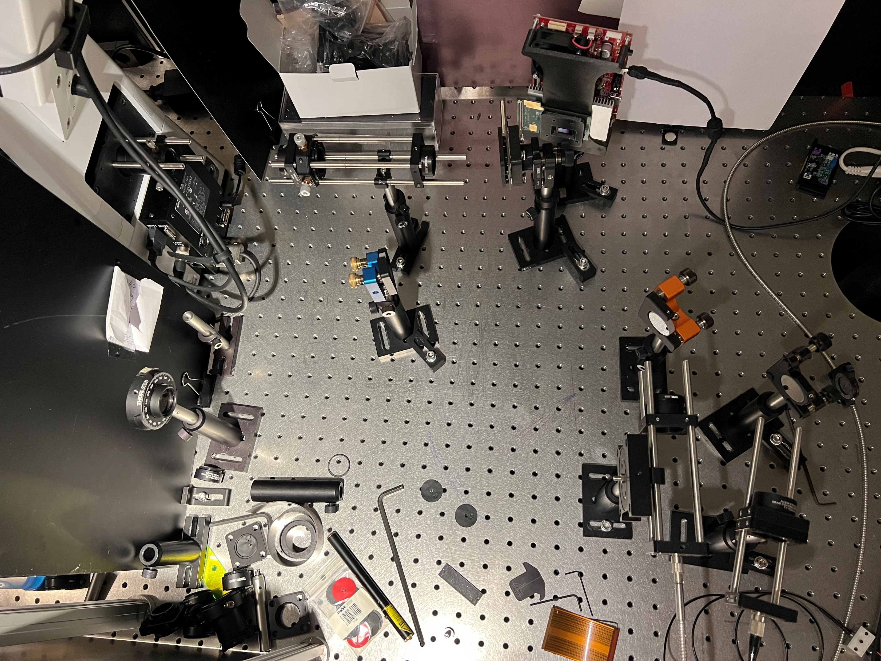
AC254-075
TL AC254-150
AC254-075

Slide 2
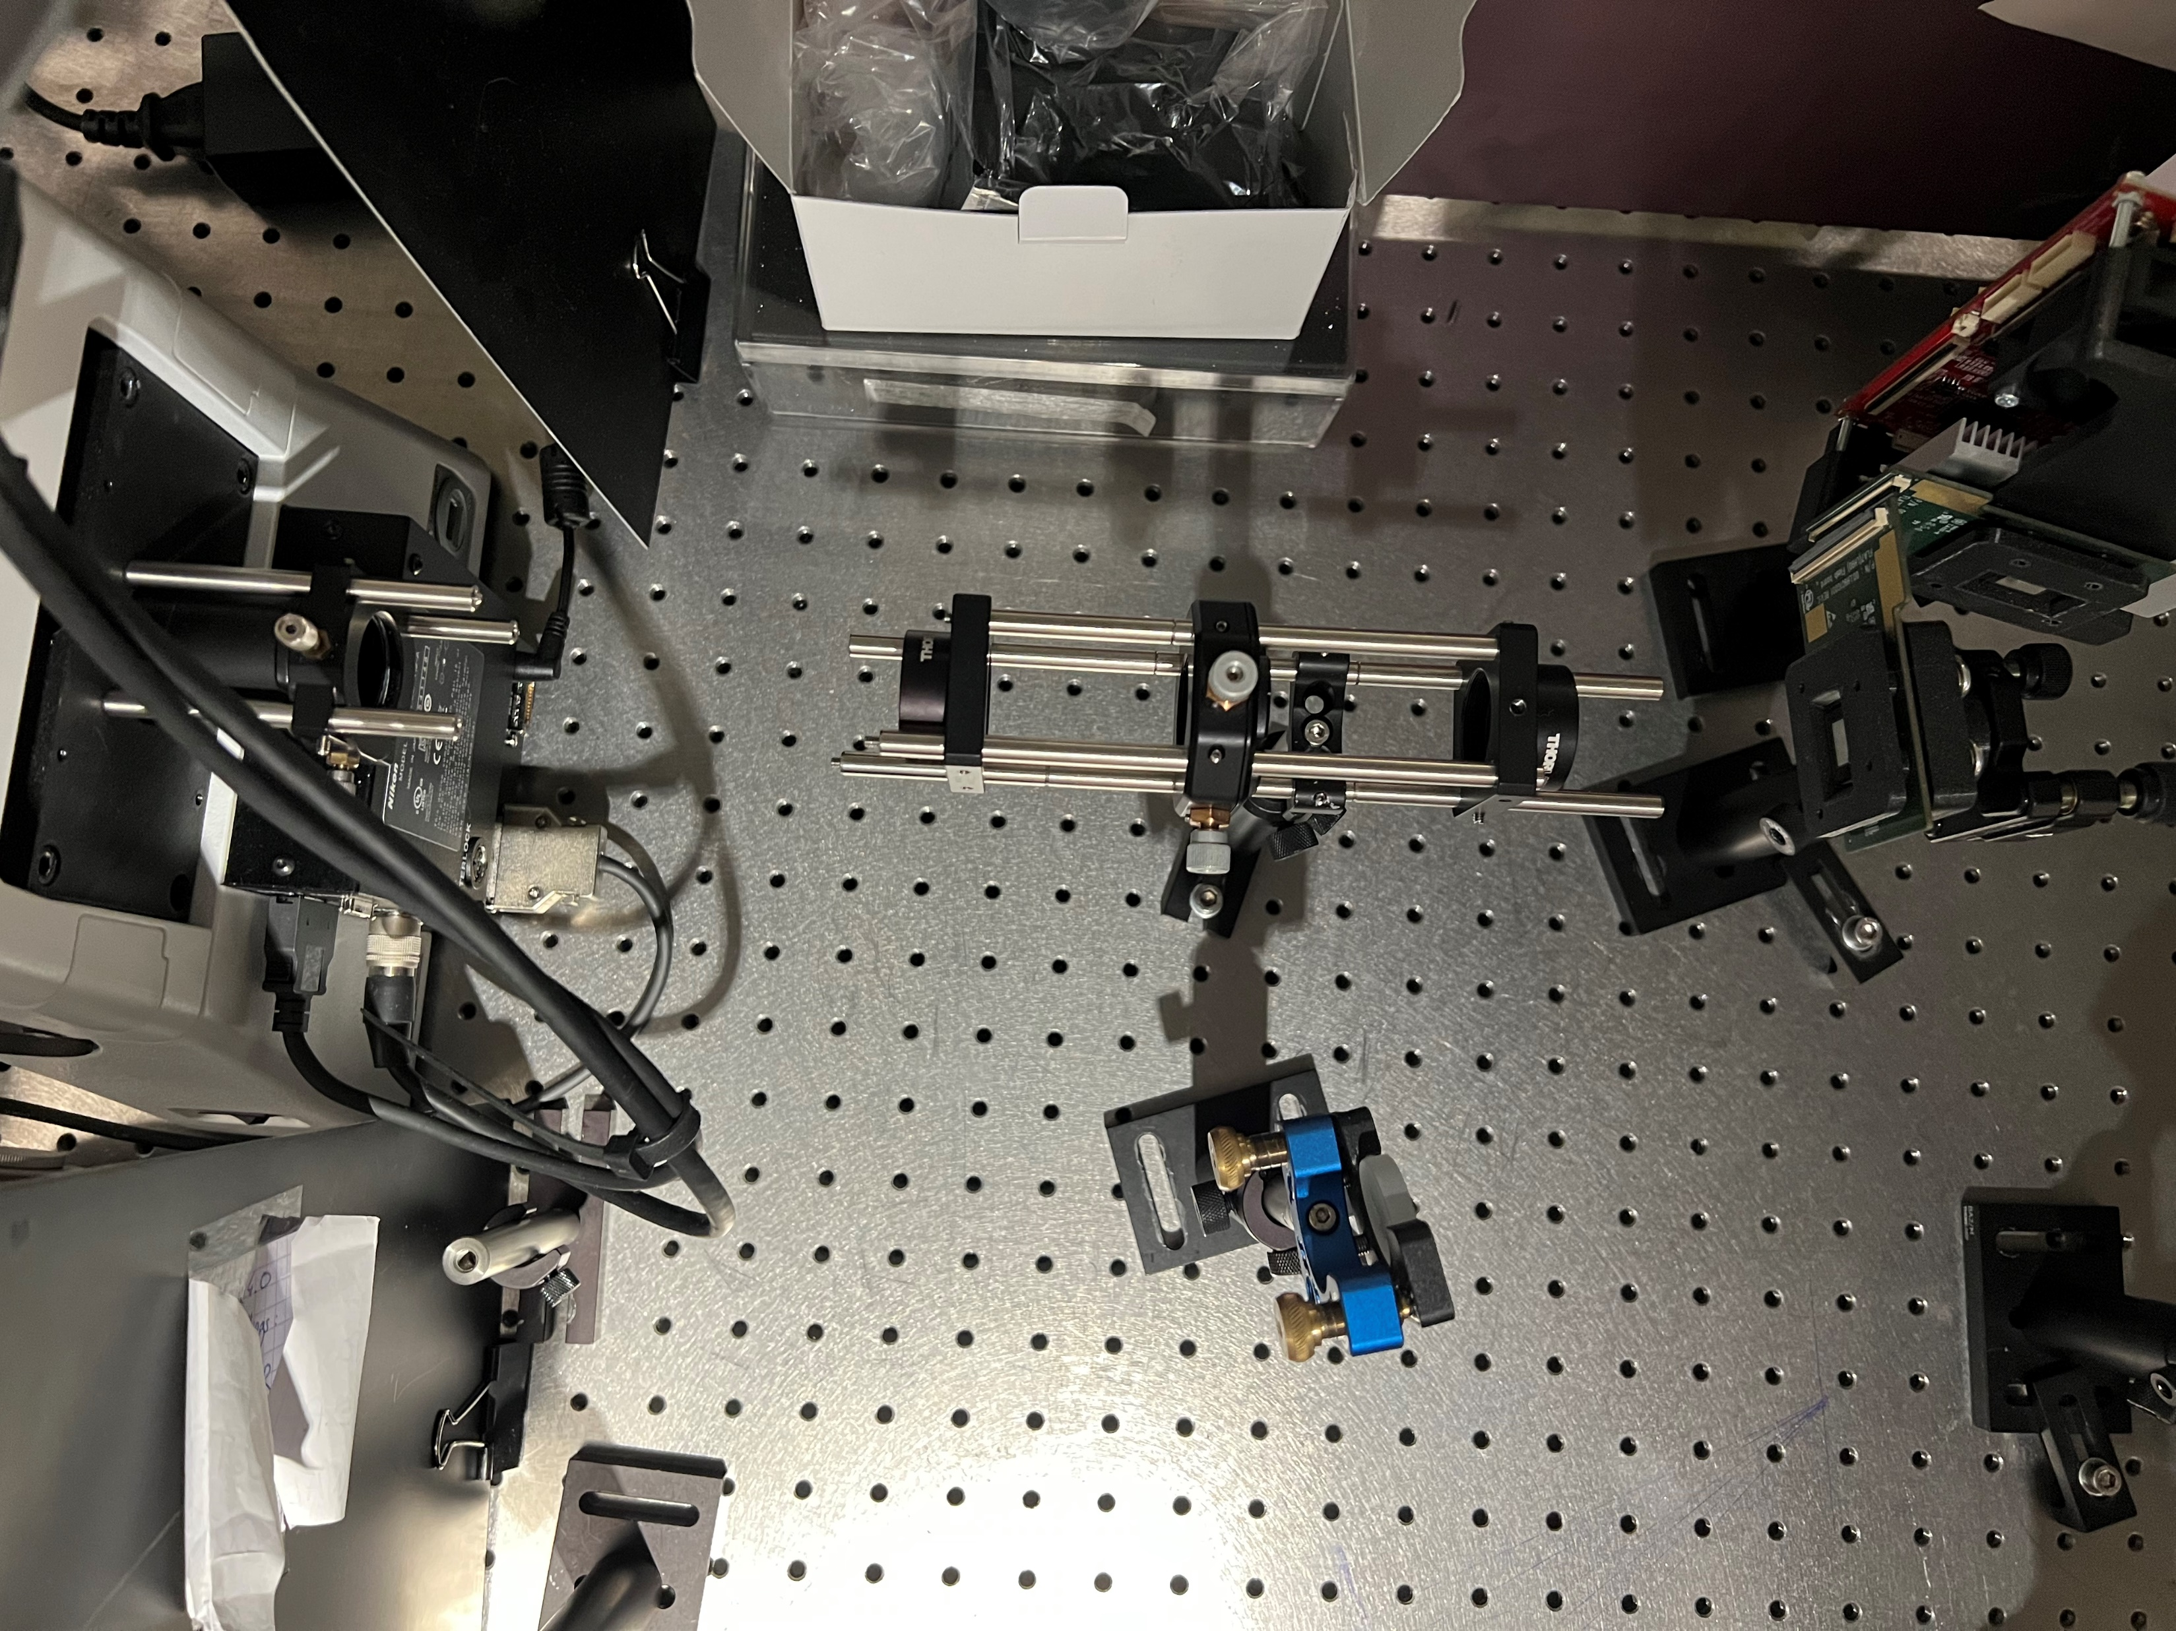
Fourier Filter

